Slide 1
The Wolf Brigade
Round 3 AI Battleground assignment
UI framework for LLM based chatbot automation utilizing Selenium with Java

Slide 2
Solution
Our repository contains a set of automated tests for Mistral Chat AI using Selenium Webriver with Java.
The tests are designed to verify the functionality and answers of Mistral Chat AI, reads the questions from the SampleQuestions_Mistral.xlsx,
compares the result from Mistral of the entire answer, it searches for a certain keyword and calculates a similarity score
based on comparison of the excel file and chat bot answer,
a clear example of reinforced learning and ensuring accuracy of the generated data of Mistal Large 2 model.
The Sample Question are basic universal knowledge, but the model responses are different for every query of the same question.
The Wolf Brigade

Slide 3
Solution details
The dataset used is GoogleNews-vectors-negative-300. We used this LLM dataset in order to compare the results of Mistral chat with it and calculate a similarity score. The assertion are made per keyword, it also compares the entire strings and calculates the Cosine Similiarity. Briefly put Mistral AI Chat is validated against the excel file and against Google dataset.
The Wolf Brigade

Slide 4
More solution details
The reading of the provided excel file SampleQuestions_Mistral.xls is done in the dedicated class called ExcelOperations.java While writing the result, the method called WriteExcel creates a new xls file called “Answers” The login is made and validated in it’s dedicated abstracted class, so it can be easily maintained and used by anyone, anywhere, Compare class validates the keywords and entire strings.
We have a main class and a class called Questions for getters and setters and a SimilarityScore class that calculates the similarity score based on a math formula, the result is printed in th console and it it also stored in the xls “Answers “ file. For full install and docker run follow the README.md file in the github repo .
The Wolf Brigade

Slide 5
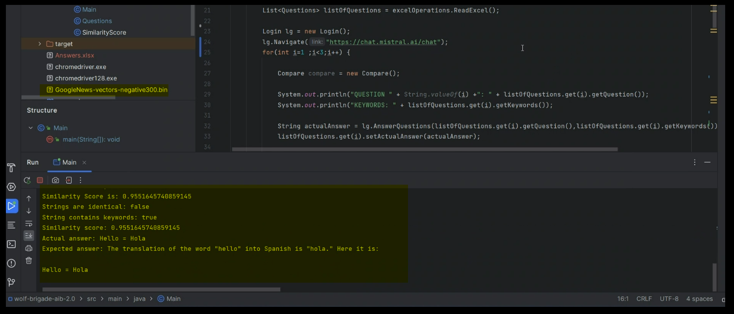
Implementation

Slide 6
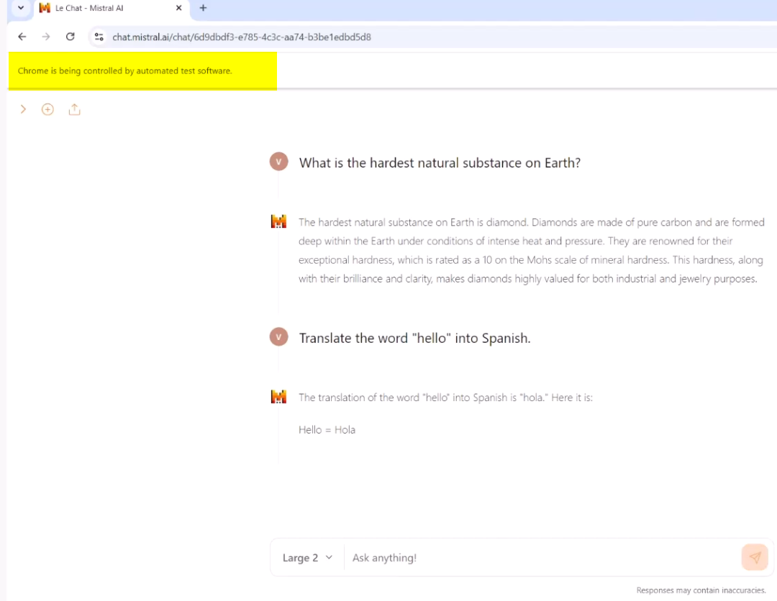

Slide 7
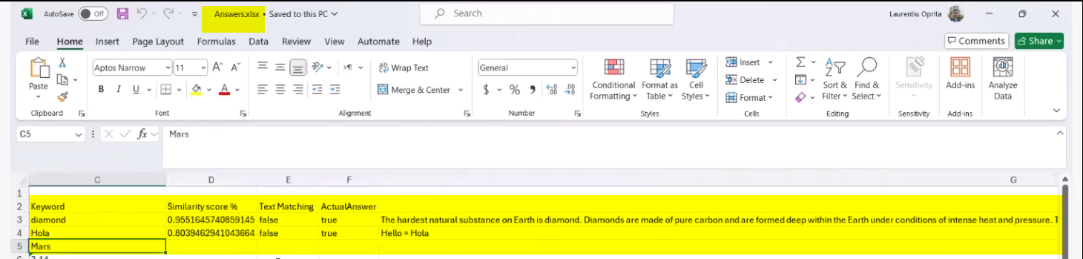
Results being stored in excel file
The Wolf Brigade

Slide 8
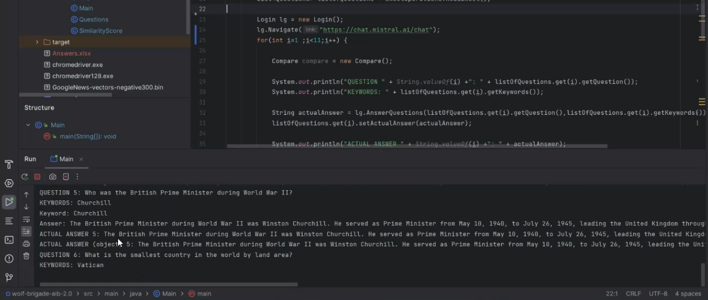
Results in console
The Wolf Brigade

Slide 9
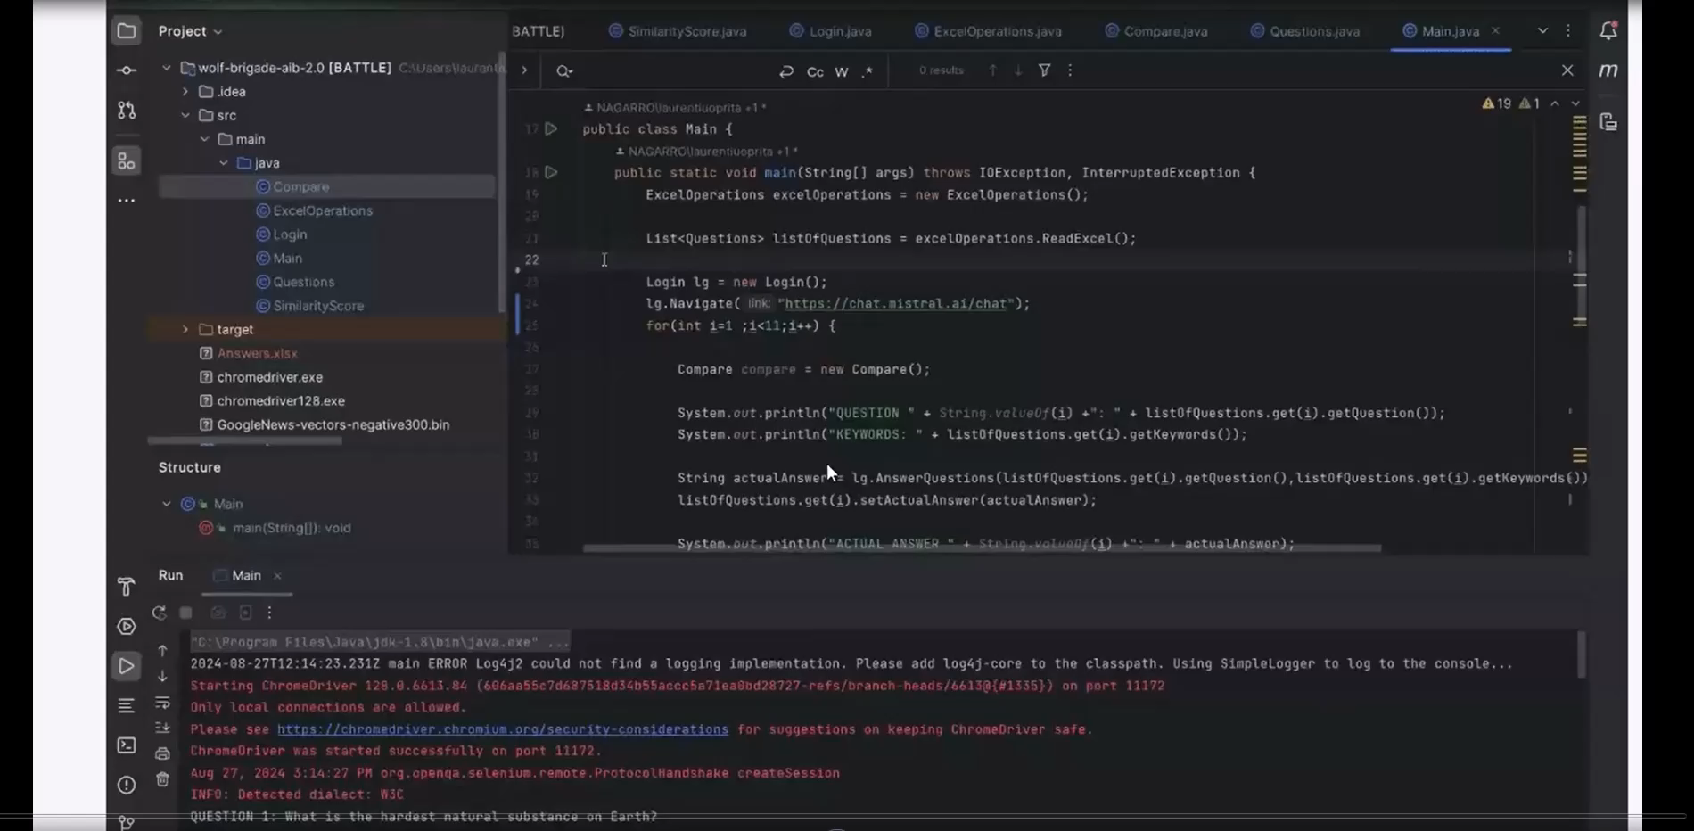
Play video*

Slide 10
Useful links
https://www.kaggle.com/datasets/leadbest/googlenewsvectorsnegative300
https://medium.com/@arjunprakash027/understanding-cosine-similarity-a-key-concept-in-data-science-72a0fcc57599
https://mvnrepository.com/artifact/org.deeplearning4j
https://github.com/deeplearning4j/deeplearning4j
https://stanfordnlp.github.io/CoreNLP/
https://deeplearning4j.konduit.ai/deeplearning4j/tutorials/language-processing/tokenization
https://github.com/VizuroiuV/wolf-brigade-aib-2.0/blob/main/README.md
https://chat.mistral.ai/chat
The Wolf Brigade

